Slide 1
Catalogue schema migration tool
Presented by Cedric CAFFY

Slide 2
Content
Liquibase
How it works
Changelog file
Configuration file
Tracking tables
Run the tool
Command line format
Migration 1.0 to 1.1
Structure of the migration folder
Changelog file
Update schema
Rollback
Migration procedures
Backward-compatible modifications
Backward-incompatible modifications
Migration on different database types
GO / NO GO

Slide 3


1. Liquibase
1.1 How it works
1.1.1 Changelog file
Text file that contains SQL Statements + Liquibase-related metadata
ChangeSet
Set of changes that Liquibase executes within one transaction
Format : --changeset userName:id_changeSet [attributes]
Advice : Do not define more than one logical change per changeset

Slide 4

1. Liquibase
1.1 How it works
1.1.2 Configuration file
Database-related .properties file

Slide 5
1. Liquibase
1.1 How it works
1.1.3 Tracking tables
DATABASECHANGELOG
Stores information about the modifications applied to the database
DATABASECHANGELOGLOCK
Ensure only one instance of Liquibase is running at one time

Slide 6
1. Liquibase
1.2 Run the tool
1.2.1 Command line format
liquibase --defaultsFile=path_to_properties –-changeLogFile=path_to_changelog_file <command>
<command>:
updateSQL
update
rollbackCountSQL
rollbackCount

Slide 7
1. Liquibase
1.3 Migration 1.0 to 1.1
1 INDEX renaming
2 CONSTRAINTS renaming
Creation of 1 UNIQUE CONSTRAINT
Update SCHEMA_VERSION_MINOR

Slide 8
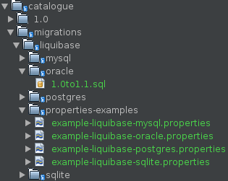
1. Liquibase
1.3 Migration 1.0 to 1.1
1.3.1 Structure of the migration folder

Slide 9
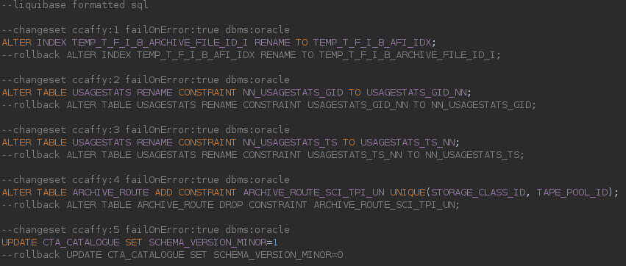
1. Liquibase
1.3 Migration 1.0 to 1.1
1.3.2 Changelog file

Slide 10
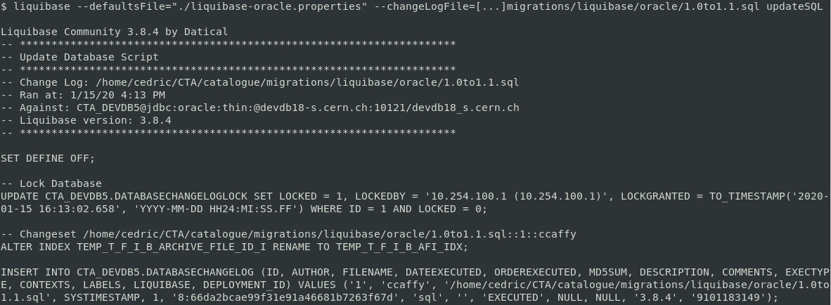
1. Liquibase
1.3 Migration 1.0 to 1.1
1.3.3 Update the schema

Slide 11
1. Liquibase
1.3 Migration 1.0 to 1.1
1.3.3 Update the schema

Slide 12
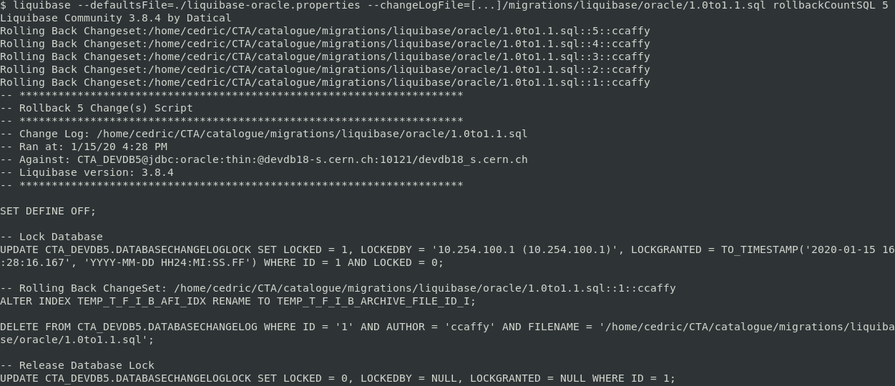
1. Liquibase
1.3 Migration 1.0 to 1.1
1.3.4 Rollback

Slide 13
2. Migration procedures
2.1 Backward-compatible modifications
The new database schema can be used by the old and the new version of CTA
Add a TABLE or a VIEW
Add a COLUMN
Remove a COLUMN that is not used by the old nor the new version of CTA
Remove a CONSTRAINT

Slide 14
2. Migration procedures
2.1 Backward-compatible modifications
Migration procedure
Backup database ?
Execute update with Liquibase
Use the cta-catalogue-schema-verify tool in order to verify the migration is successful

Slide 15
2. Migration procedures
2.2 Backward-incompatible modifications
Database schema is modified in a way that it can not be used by the old version of CTA
Rename a COLUMN, a TABLE or a VIEW
Change the data type of a COLUMN
Remove a COLUMN, a TABLE or a VIEW that is still used by the old version of CTA

Slide 16
2. Migration procedures
2.2 Backward-incompatible modifications
Rename a COLUMN, a TABLE or a VIEW
(COLUMN taken as example)
Add the COLUMN the with the new name and same datatype as the old one
Copy data from the old COLUMN to the new one
=> Add trigger to sync between both columns ?
=> If triggers not supported : two versions of CTA should be released
Update CTA_CATALOGUE version
Update all CTA components with the new version of CTA

Slide 17
2. Migration procedures
2.2 Backward-incompatible modifications
Change the data type of a COLUMN
Same as previously, but we need to convert the values in between

Slide 18
2. Migration procedures
2.2 Backward-incompatible modifications
Remove a COLUMN, a TABLE or a VIEW
Update all CTA components
With the old schema version number associated to it
Run the migration tool
Update all CTA components in order to change the schema version it is supposed to run against

Slide 19
2. Migration procedures
2.2 Backward-incompatible modification
Conclusion
Complexity of these modifications require a case-by-case migration plan
Create transition version of CTA that can run against "in-between" schema
Inform the user that a complex migration can be run only once and will not be rollbackable
Each complex migration could be documented in eoscta-docs
Create topic like "Migration from database schema version 1.6 to 2.0"

Slide 20
2. Migration procedures
2.3 Migration on different database types
An easy migration on one database type can be a more tricky migration in another database type
Example : Renaming a CONSTRAINT "x" to "y" on table A
ORACLE
ALTER TABLE A RENAME CONSTRAINT x TO y;
SQLITE
Create a new table A-BIS that is the same as A
Copy content of A in A-BIS
DROP TABLE A
CREATE TABLE A with new constraint y
Suggestion : We do not create migration scripts as long as the related database type is not in production

Slide 21
3. GO / NO GO
Team decision
GO ? NO GO ?
If GO, I will create a documentation summarizing and explaining the migration procedures in eoscta-docs

